Slide 1
Introduction to the AWS Cloud Platform
Ravindu Nirmal Fernando 2x AWS Community Builder | STL @ Sysco LABS

Slide 2
Agenda
Introduction to AWS cloud platform and its benefits
AWS Global Infrastructure
Accessing AWS Services
Interacting with AWS Services
Best Practices for managing AWS Accounts
Common AWS services
Demo

Slide 3

What is AWS Cloud?
AWS Cloud is a cloud computing platform that provides a wide range of services, including compute, storage, databases, security, networking, analytics, machine learning, and DevOps etc...
AWS Cloud is a highly scalable and reliable platform that can be used to build and deploy applications of all sizes and complexity.
AWS Cloud is also a cost-effective platform, as you only pay for the resources that you use.

Slide 4
Benefits of using AWS Cloud?
Scalability - Easily add/ remove resources as required
Reliability - Backed by reliable AWS network with proven track record of uptime and performance
Cost-effectiveness - Pay only for what you use
Security - Wide range of security features and services to protect your data
Innovation - 200+ fully featured services for a wide range of technologies, industries, and use cases
Notes:
Scalability: AWS Cloud is highly scalable, meaning that you can easily add or remove resources as needed to meet your changing business needs.
Reliability: : AWS Cloud is highly reliable, with a proven track record of uptime and performance.
Cost-effectiveness: AWS Cloud is a cost-effective platform, as you only pay for the resources that you use.
Security: AWS Cloud is a secure platform, with a wide range of security features and services to protect your data.
Innovation: AWS Cloud is constantly innovating, with new services and features being added on a regular basis.

Slide 5
AWS Global Infrastructure
AWS Global infrastructure consists of a network of data centers located around the world. These data centers are organized into Regions and Availability Zones.
A Region is a geographical area that contains multiple Availability Zones. An Availability Zone is a logically isolated section of a Region.
AWS Edge Locations are locations around the world where AWS content is cached. This allows users to access AWS content with lower latency and improved performance.
Regional Edge Caches are caches of frequently accessed AWS content that are located in close proximity to AWS customers. This allows users to access AWS content with even lower latency and improved performance.
Notes:
Regional Edge Caches sits between the origin server and the Edge Locations and has a larger cache

Slide 6
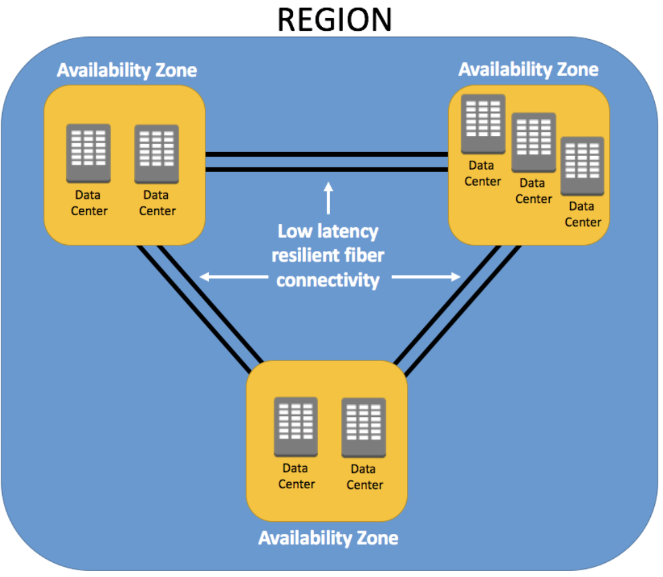
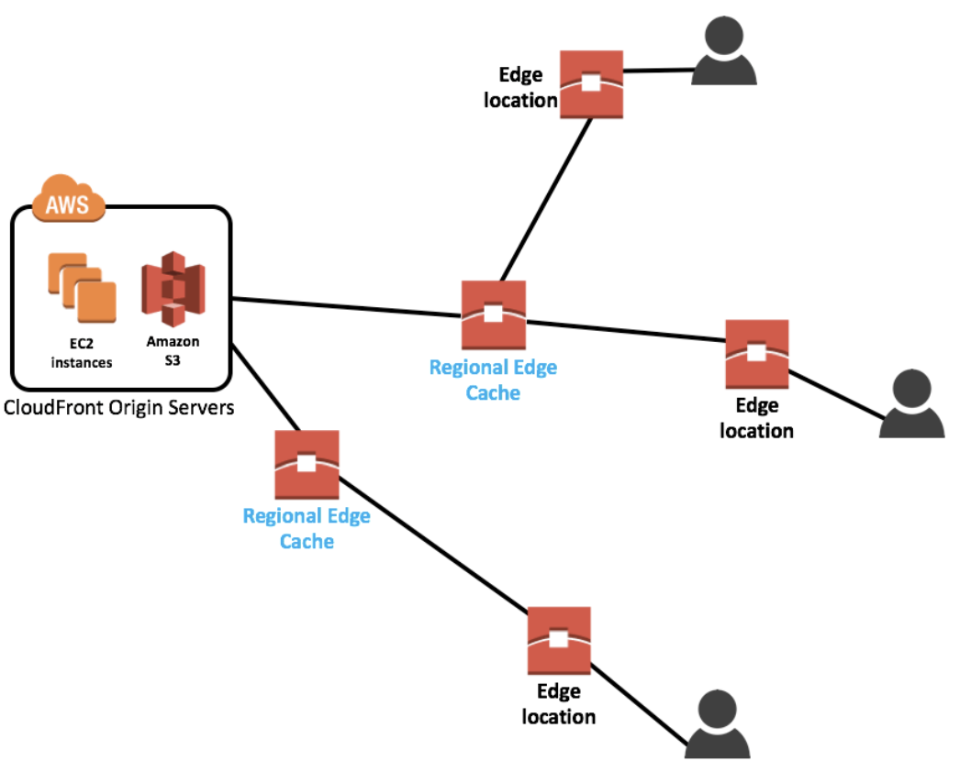

Slide 7
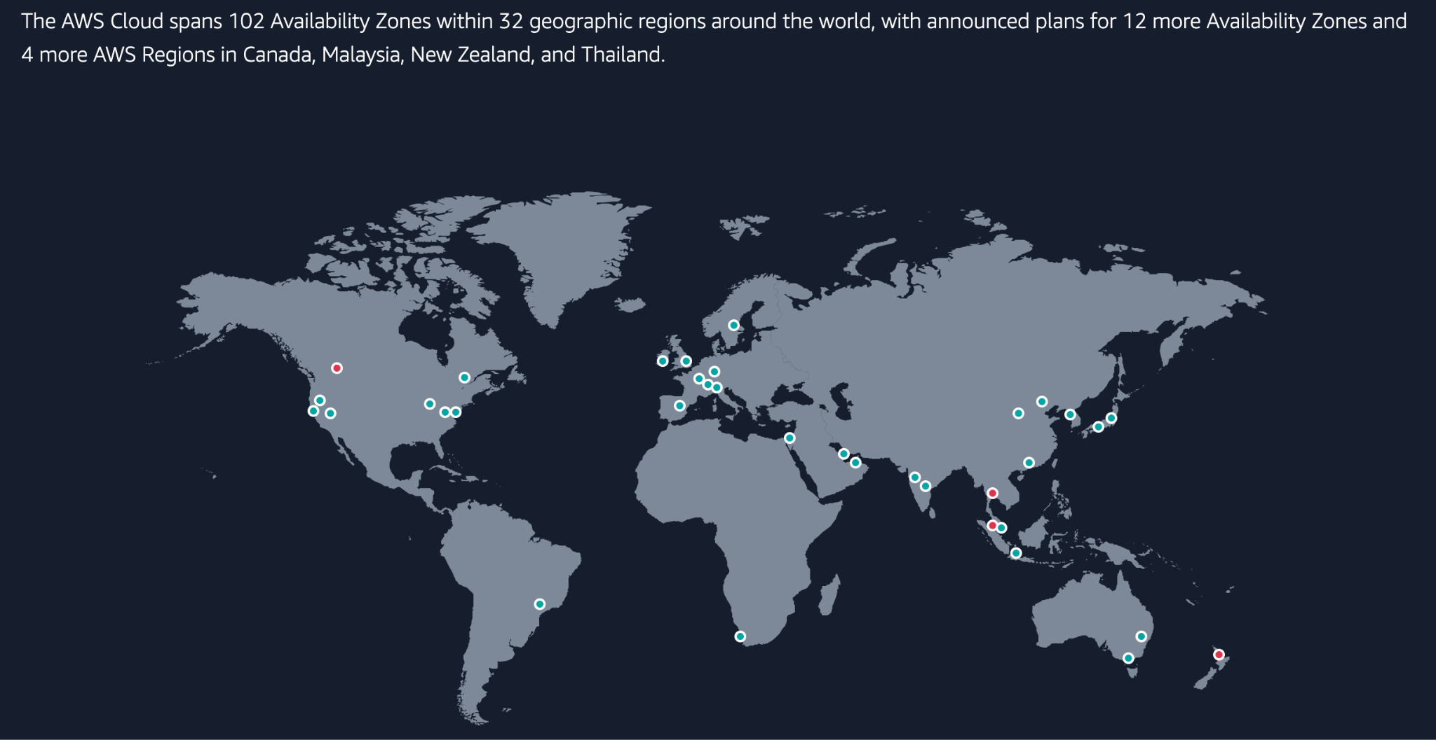

Slide 8
Accessing AWS Services
AWS IAM (Identity and Access Management) - service that allows you to manage user access to your AWS resources.
IAM allows you to create Users and Groups, and assign them permissions policies to specific AWS resources. Users have long term credentials.
IAM Roles - Very similar to a user, in that it is an identity with permission policies that determine what the identity can and cannot do in AWS. But no credentials.
IAM Policies - Documents that specify the permissions that are granted to users, groups, or roles. Used to determine what actions a user, role, or member of a user group can perform, on which AWS resources, and under what conditions. determine what actions a user, role, or member of a user group can perform, on which AWS resources, and under what conditions.

Slide 9
Interacting with AWS Services
AWS Management Console
AWS Command Line Interface
Software Development Kits
mine what actions a user, role, or member of a user group can perform, on which AWS resources, and under what conditions.

Slide 10
Best Practices for managing AWS Accounts
Use strong passwords, enable password policy and enable multi-factor authentication.
Create IAM users and roles and assign them permissions to specific AWS resources.
Use security groups, Network Access Controls and VPCs to protect your resources.
Implement monitoring and logging to track your AWS usage and identify potential problems.

Slide 11
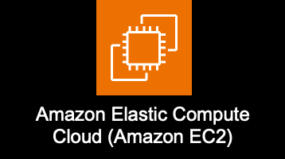


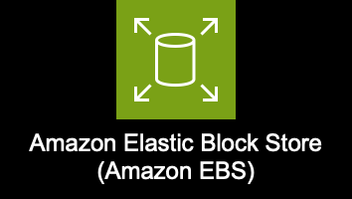

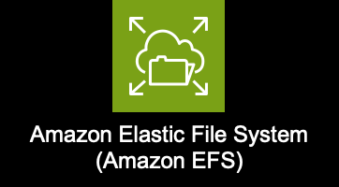
Common AWS Services
Compute
Amazon Elastic Compute Cloud (EC2)
Amazon Elastic Container Service (ECS)
AWS Lambda
Storage
Amazon Simple Storage Service (S3)
Amazon Elastic Block Store (EBS)
Amazon Elastic File System (EFS)
mine what actions a user, role, or member of a user group can perform, on which AWS resources, and under what conditions.

Slide 12
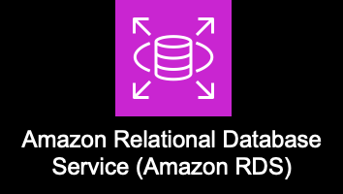
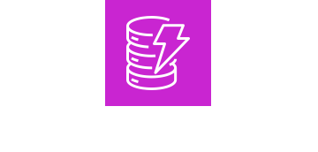
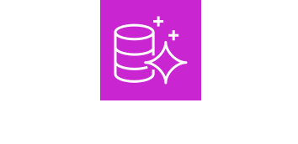
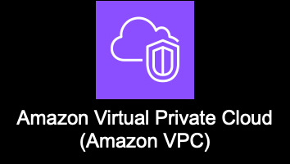

Common AWS Services
Databases
Amazon Relational Database Service (RDS)
Amazon DynamoDB
Amazon Aurora
Networking and Content Delivery
Amazon Virtual Private Cloud (VPC)
Amazon Route 53
Amazon CloudFront
mine what actions a user, role, or member of a user group can perform, on which AWS resources, and under what conditions.

Slide 13
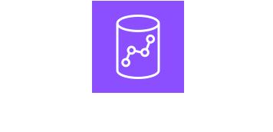


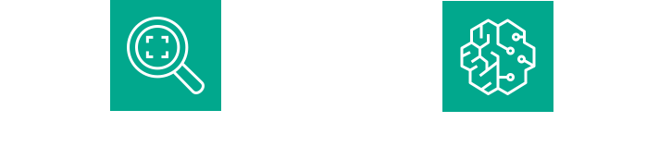

Common AWS Services
Analytics
Amazon Redshift
Amazon Athena
Amazon Kinesis
Machine Learning
Amazon SageMaker
Amazon Rekognition
Amazon Comprehend
Amazon BedRock
mine what actions a user, role, or member of a user group can perform, on which AWS resources, and under what conditions.

Slide 14
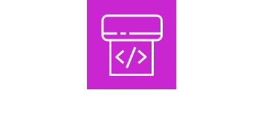
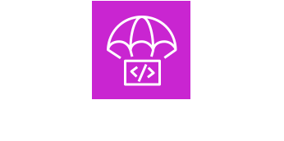

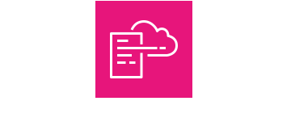

Common AWS Services
DevOps
AWS CodePipeline
AWS CodeDeploy
Management & Governance
AWS CloudFormation
Amazon CloudWatch
Amazon CloudTrail
mine what actions a user, role, or member of a user group can perform, on which AWS resources, and under what conditions.

Slide 15


Common AWS Services
Application Integration
Amazon SNS
Amazon SQS
Amazon EventBridge
AWS Step Functions
mine what actions a user, role, or member of a user group can perform, on which AWS resources, and under what conditions.

Slide 16
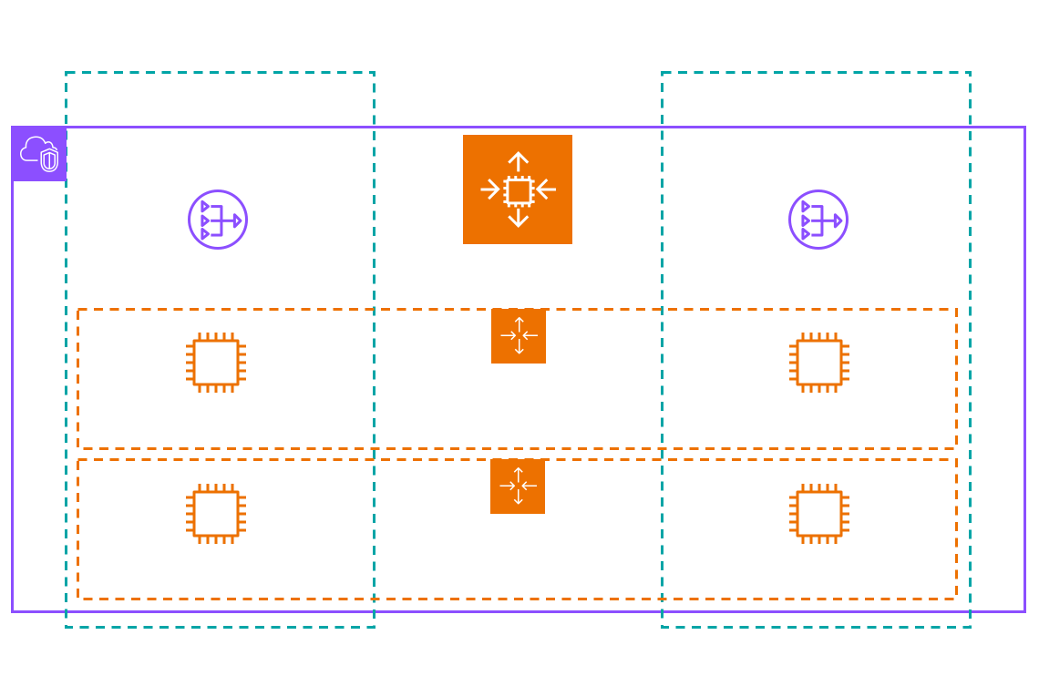

Slide 17
DEMO TIME…

Slide 18
Thank You!!!

